Slide 1
Journey PPT – Week 7 (03/10/23 – 04/10/23)
Megha Sharma
Associate Data Engineer
Emp ID: 654810

Slide 2
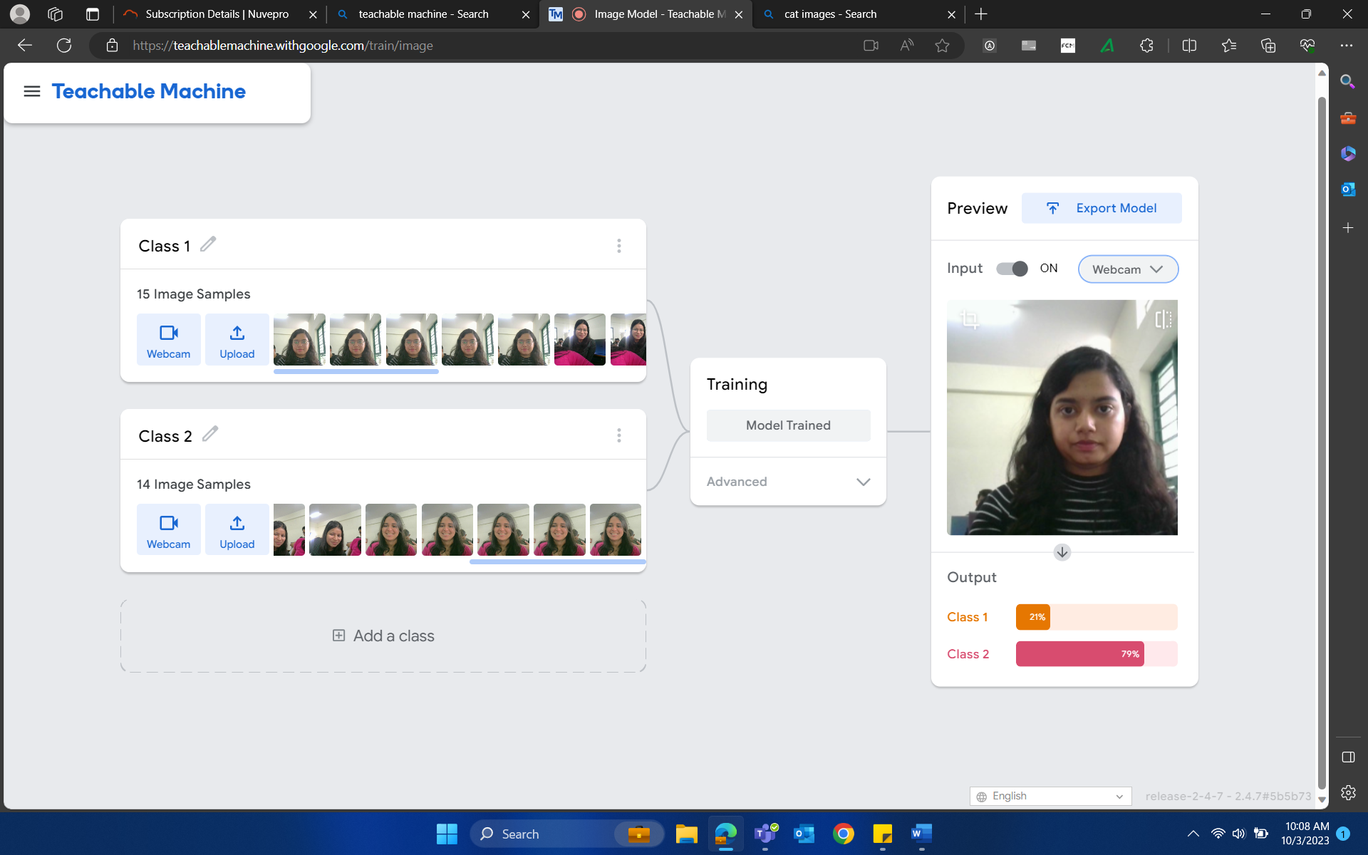
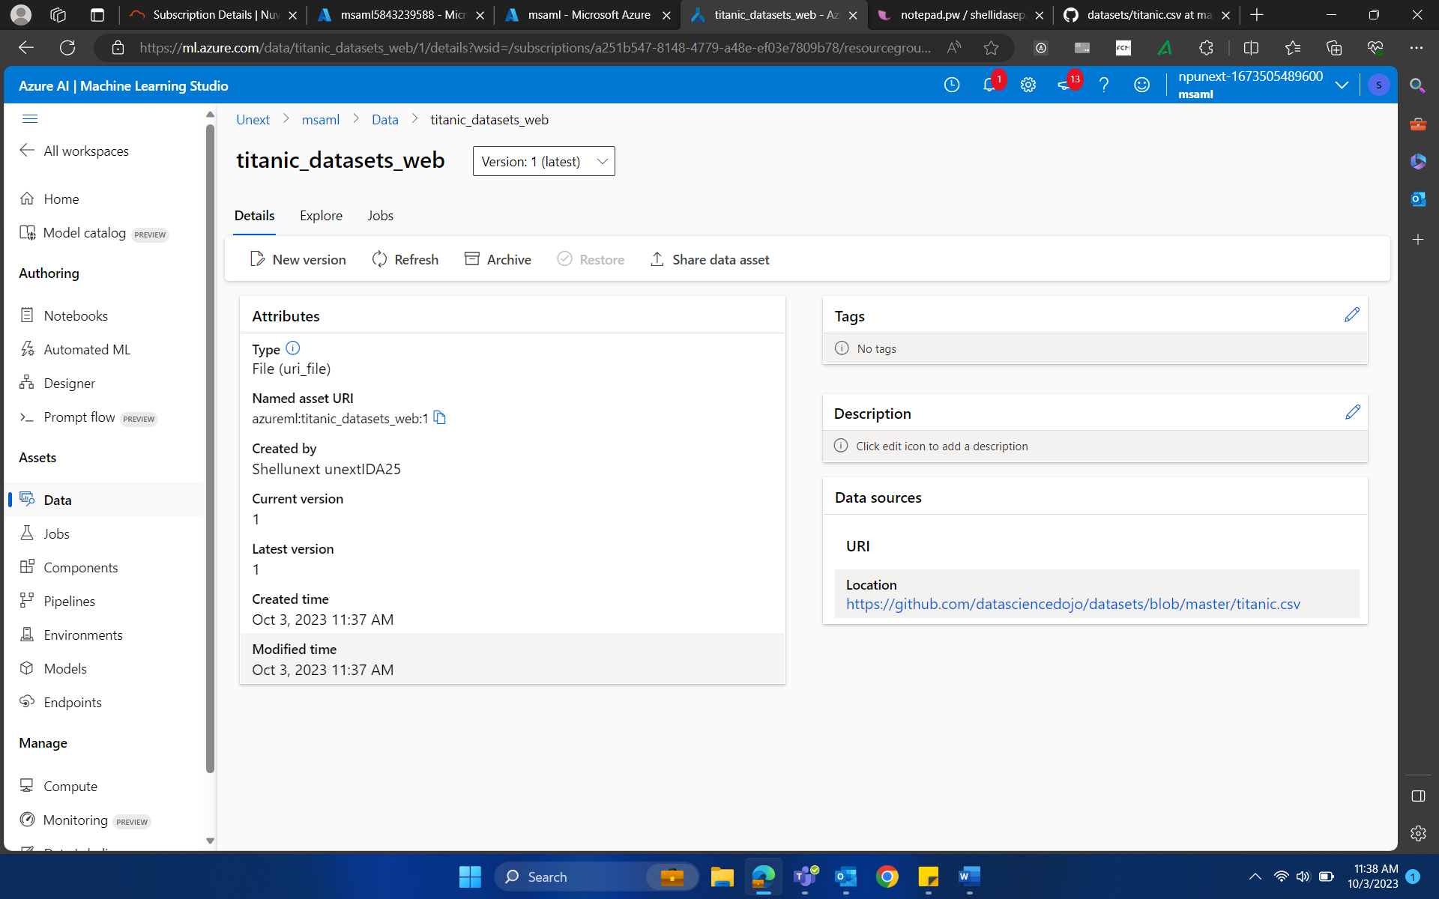
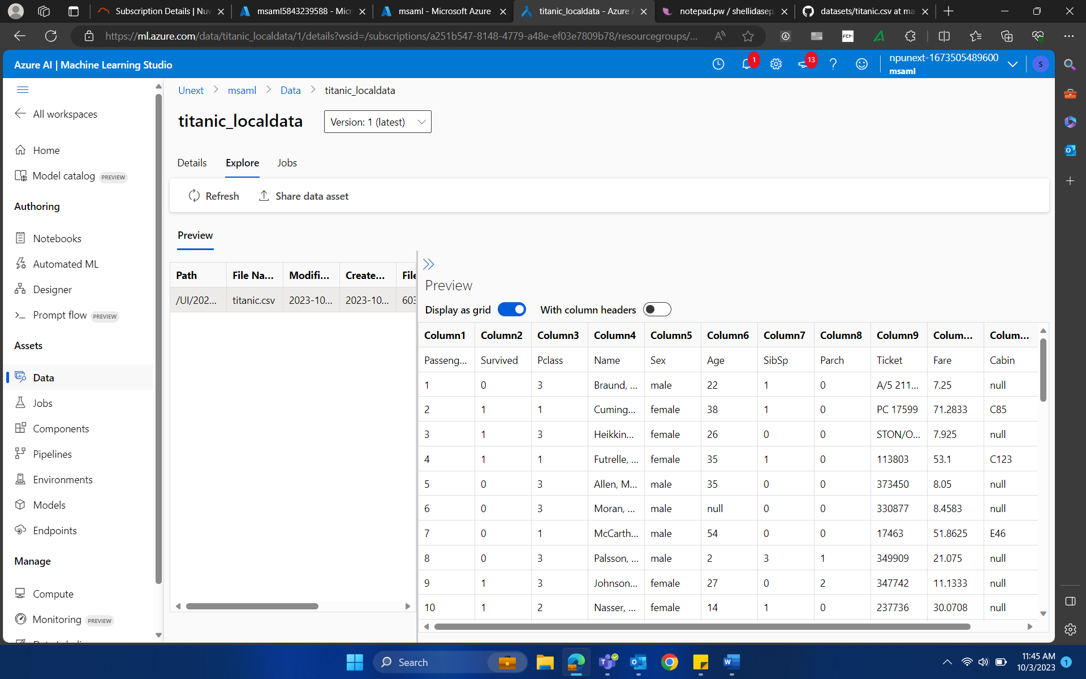
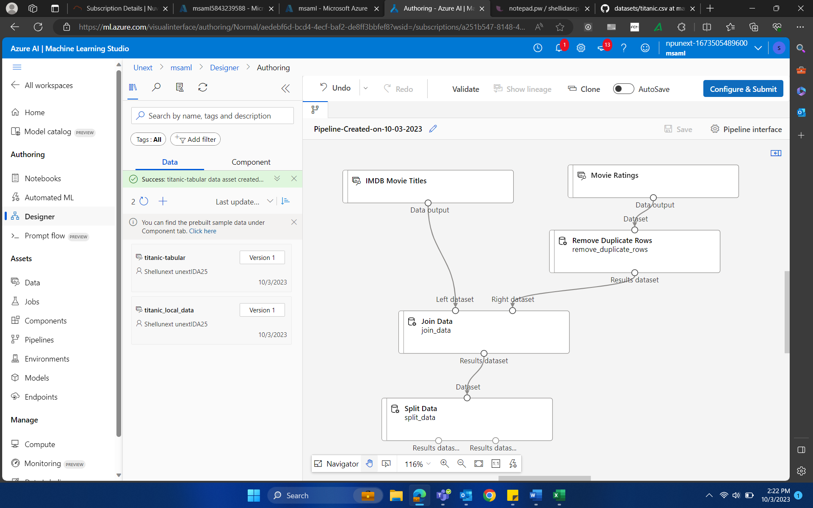
03-Oct-23 (Tuesday) – ML Studio

Slide 3
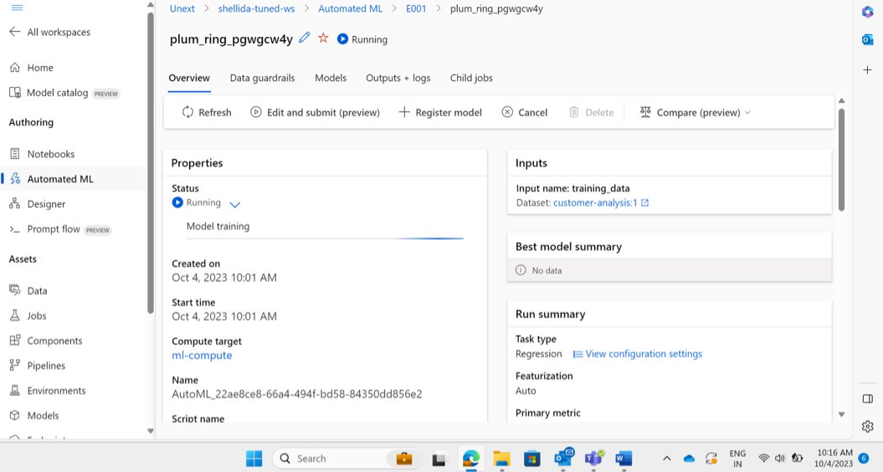
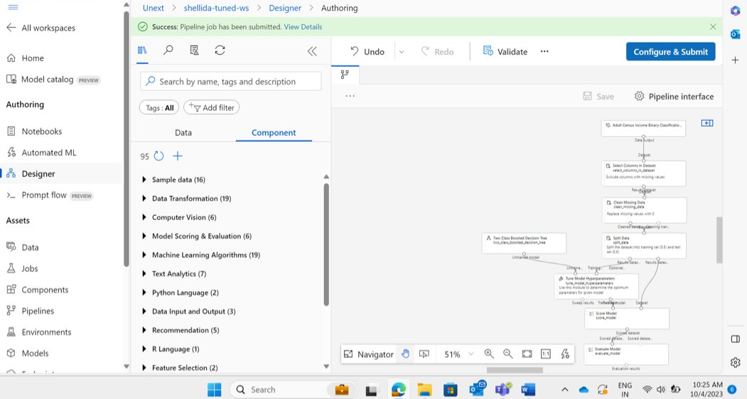
04-Oct-23 (Wednesday) – ML Studio

Slide 4
THANK YOU

